Slide 1
Leave Management System (Phase 1)
Adam Lewis – 17021294
Jake Bulmer - 17144132
Liam Newton -17013658
Adam May -17129303

Slide 2
What we are doing
We are required to make a Leave Management System, with a user-friendly Graphical User Interface. The Leave Management System will allow users to do multiple of things, the main purpose however is to track and book time off.

Slide 3
Team roles
Liam Newton – Scrum Master
Adam Lewis – Product Owner
Jake Bulmer – Development Team
Adam May – Development Team

Slide 4




Process
Find out main objective – Leave Management System
Create roles within the team
Research
Create a specification list along with some designs.
Rely what has been done to the team through Trello and Slack

Slide 5
Communication

Slide 6
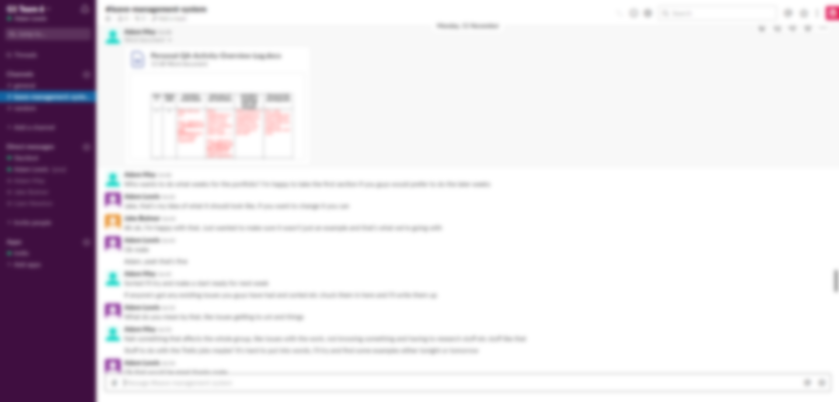
Slack

Slide 7
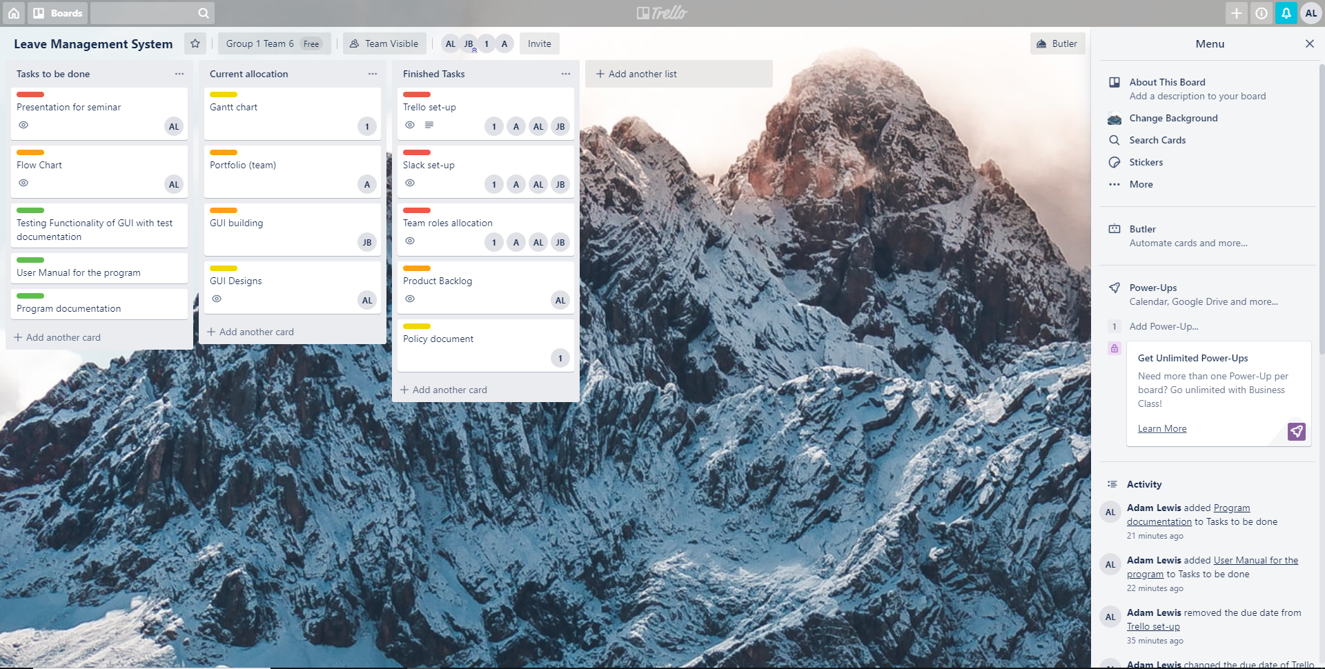
Trello

Slide 8
Design

Slide 9
Why Tkinter?
Familiarity
Free
Most widely used GUI package for python
Simple to use
Easy to set-up

Slide 10
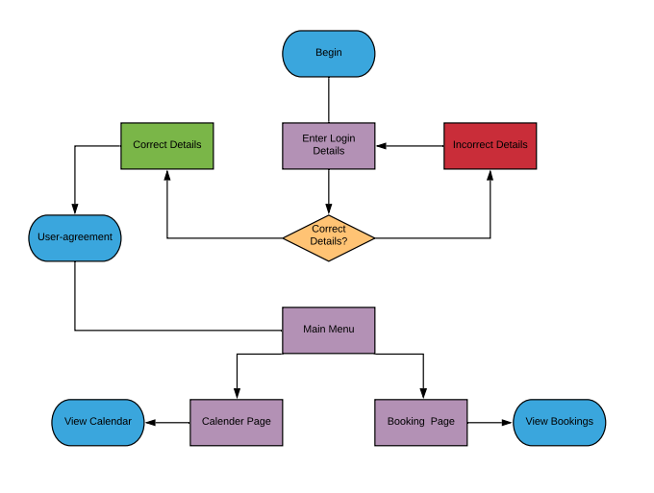
Flowchart

Slide 11
UML Diagram

Slide 12
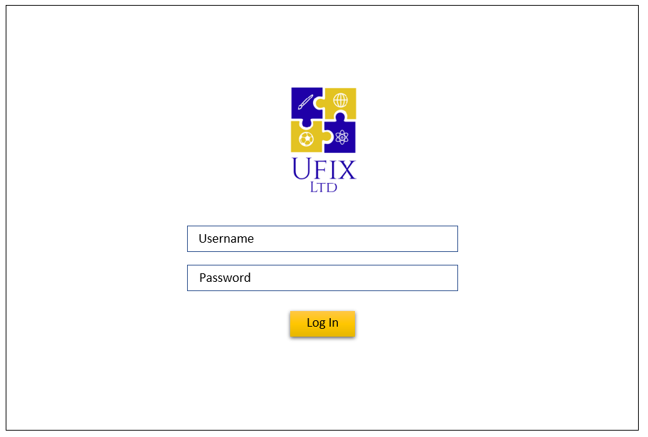
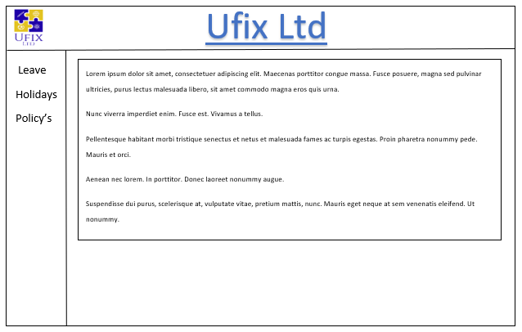
GUI Designs
Log In Page
Main Page

Slide 13
Development

Slide 14
Quality Assurance
Our Quality Assurance consists of
Design
Testing
Feedback
Everything is important in Quality Assurance but as a team what we focus on is testing. By allowing testing to the main focus, we can provide a professional and an industry standard program.
To make sure our current work is the best it can be, we communicate thoroughly while working on the project.

Slide 15
Policy

Slide 16
Thanks For listening!

Slide 17
Any Questions?

